Slide 1

Analytics Assignment
By – Satyam Khorgade

Slide 2
Monthly Transactions
There appears to be a slight seasonal trend, with higher Transactions in the first and fourth quarters of year.

Slide 3
Most Popular Products/Services:
Beauty Bliss is our most popular services followed by Tech Touch and others

Slide 4
Daily Revenue Trend:
Daily revenue fluctuates throughout the year, but there is a general upward trend

Slide 5
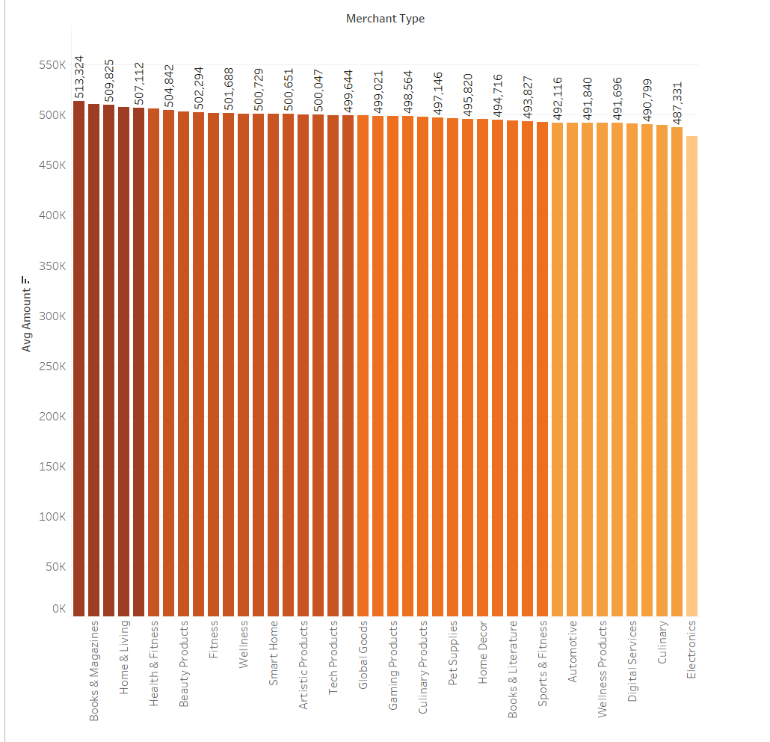
Average Transaction Amount by Product Category:
Average Revenue By books &magazines is highest and Electronics is the Lowest

Slide 6
Transaction Funnel Analysis:
Completed
Pending
Cancelled
18101
18181
18274

Slide 7
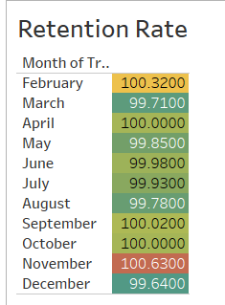
Monthly Retention Rate:
Overall, the company's retention rate is good, consistently above 99%. This means that the vast majority of customers are staying with the company for at least the next month.
There is a slight downward trend in the retention rate throughout the year. This could be due to a number of factors, such as customers getting bored with the service, finding a better deal elsewhere, or simply not needing the service anymore.
The lowest retention rate is in December, at 99.64%. This could be due to the holidays, as people may be less likely to think about their subscriptions during this time.
The highest retention rate is in April, at 100%. This could be due to a number of factors, such as a new marketing campaign or a product launch.

Slide 8
Thank you

